Slide 1

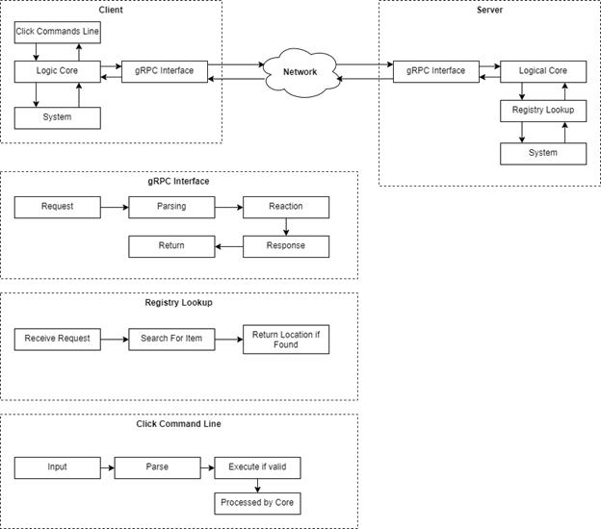
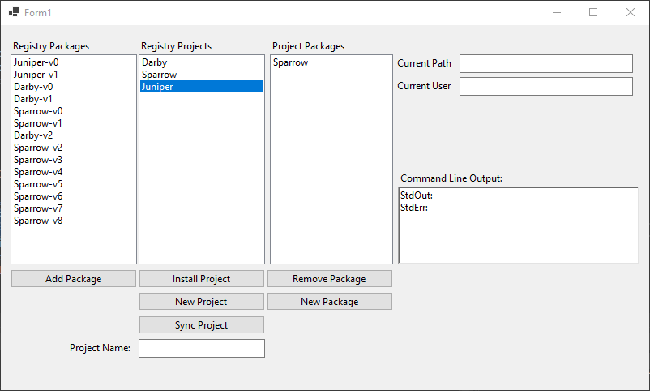
Package Bird: Software Package Management Sponsor: Brandon Busby Mentor: Brandon Busby Elisha Aguilera, Setenay Güner, Denish Oleke
Problem Statement
Requirements
Approaches
Architecture Overview
Technologies Used
GRPC
Go language version 1.18
Cobra-Cli
Microsoft Visual C#
Microsoft WinForms
MongoDB
Future Work
Support more build tools by default
Improved caching by integrating Redis (database caching tool)
Better package diagnostic tools
Often, software applications are designed to use other, previously existing software components. This dependency of software applications on other software components or libraries may result in numerous dependency problems, such as long chains of dependencies, conflicting dependencies, and circular dependencies.
Develop a dependency management system so that a build of package always knows what version of the package’s dependencies to use.
Look up files, add, remove, and edit packages and projects.
Glossary
CLI : command-line interface
gRPC: Google Remote Procedure Call, remote network methods framework
Package (Software): A unit or module of code
Client-server model
Bidirectional communication
Divided into front-end, back-end, database
Graphical Interface Application
Outcomes
Back-end interface for registering, accessing packages
Front-end command line application for portability
Front-end graphical interface for usability and discoverability
Acknowledgements
Brandon Busby (Amazon),
Dr. Bolong Zeng
Team Apollo

Slide 2


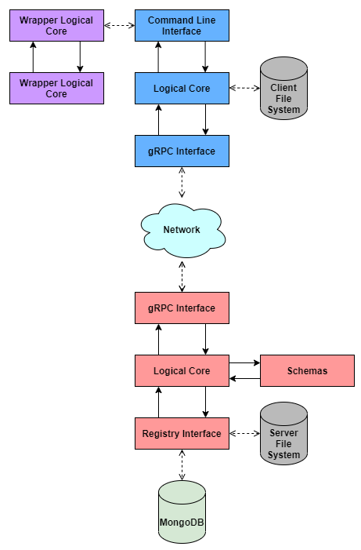

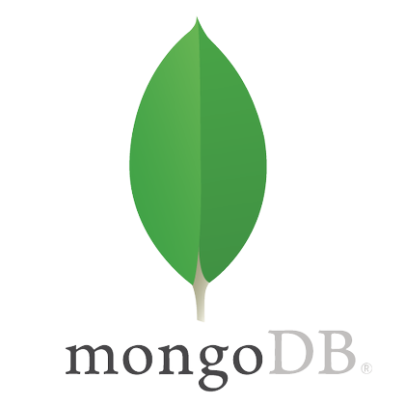

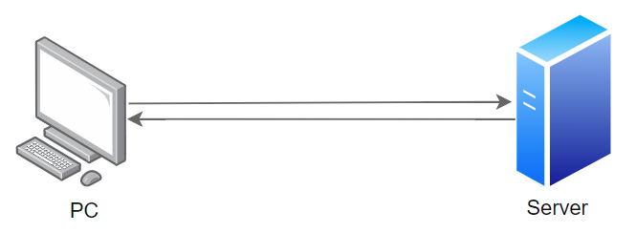
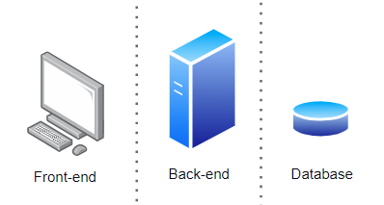
Sponsor and mentor: Brandon Busby Elisha Aguilera, Setenay Güner, Denish Oleke
Problem Statement
General Software Architecture
Technologies Used
Often, software is designed to use other, previously existing software. This dependency of software may result in numerous dependency problems.
Requirements
Develop a dependency management system so that a build of package always knows what version of the package’s dependencies to use.
Look up files, add, remove, and edit packages and projects.
Future Work
Support more build tools by default
Improved caching by integrating Redis (database caching tool)
Better package diagnostic tools
Approaches
Glossary
Client-server model
Bi-directional communication
Graphical Interface Application
CLI : command-line interface
Package (Software): A unit or module of code
Outcomes
Acknowledgements
Registering & accessing packages
Brandon Busby (Amazon AWS),
Dr. Bolong Zeng
CLI and GUI
Team Apollo

